Slide 1
New York Listings
IST-687
Zachary Reisz
Victor Nunez
Nick Starr
Heather Ford

Slide 2
Taking Your Business Personally.
Agenda
01
Introduction
02
Business Questions
03
Descriptive Statistics and Visualization
04
Interpretations

Slide 3
Introduction

Slide 4

Introduction
Objective
To determine where to focus marketing efforts in order to attract new hosts that will achieve the highest price rentals.
Notes:
New York City is one of the top tourist destinations in the US and visitors have numerous options when it comes to lodging. We want to make sure that airbnb makes their short list. In order to achieve this we want to continue to increase our host options. We set out to understand where to market to new hosts based on achieving the highest price for a rental. This marketing would be direct mail to residences that met the optimal criteria.

Slide 5
Data
47,840 records evaluated
Number of Reviews
Last Review (assumed as stay date)
Room Type
Price
Availability
Minimum Nights
Neighborhood Group
Neighborhood
Host listing count
Location
Property Type
Reviews

Slide 6
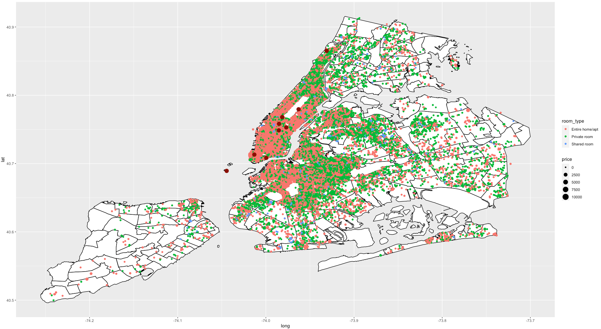
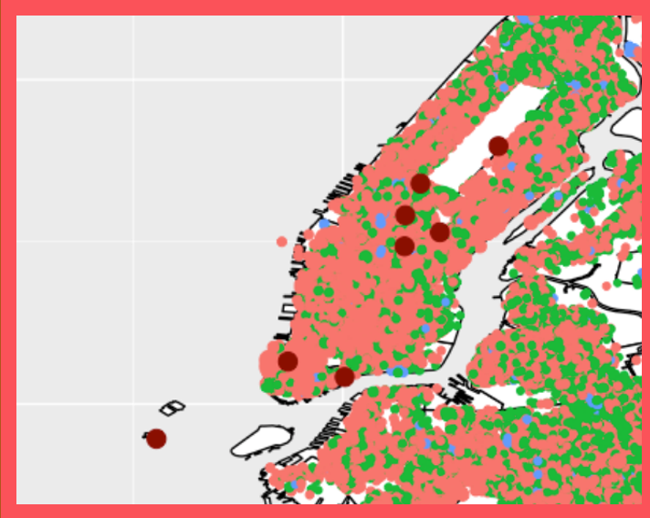

Notes:
~49,000 New York City Air BnB listings: color based on Room Type; size based on Price.
9 points of interest are major tourist sites in neighborhoods that rank above average of the entire city (Statue of Liberty, World Trade Center, Brooklyn Bridge, Empire State Building, Grand Central Station, Times Square, Columbus Circle, The Metropolitan Museum of Art, The Cloisters)
Neighborhood breakdowns on a following slide
Zooming in to Lower Manhattan accentuates larger sized coral colored points shows location and room type are the strongest factors affecting the price

Slide 7
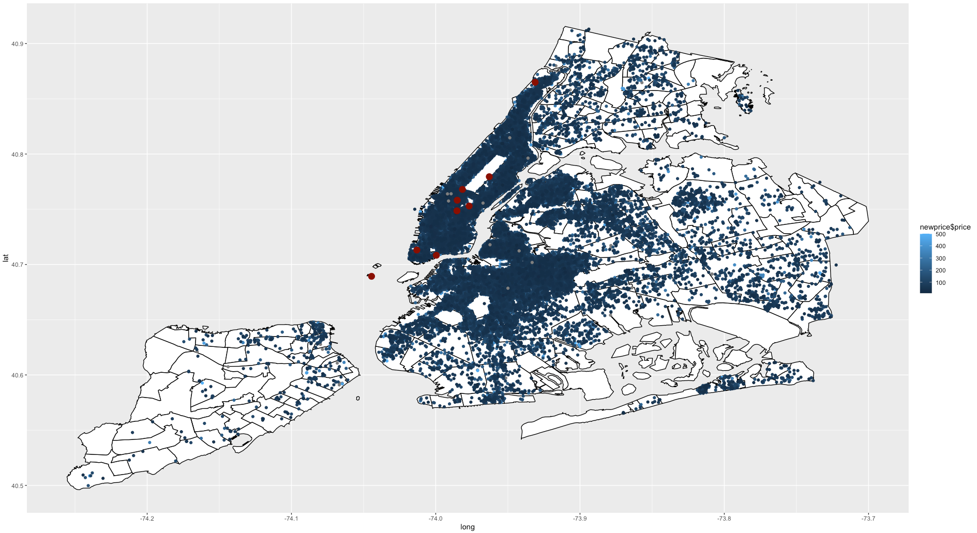
Notes:
Color is based on Price up to $500 per night rate; still accounts for ~48,000 New York City Air BnB listings
Chose to use the sample of Price as color because that is the variable our business questions mainly address.
The Landmarks are in areas lighter/above the average rate of $152

Slide 8
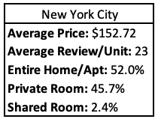
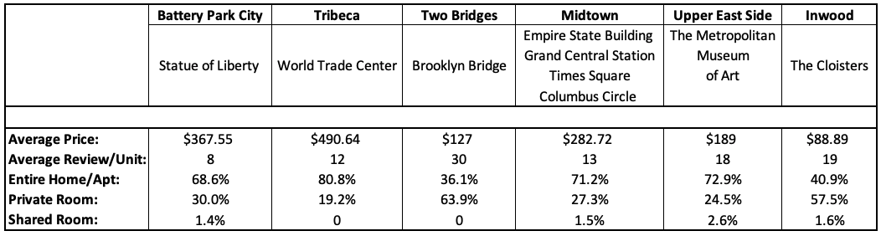
Popular Landmarks
Notes:
Some popular tourist attractions, with their neighborhood information:
The data shows location and room type are the strongest factors affecting the price
These landmarks are located in popular neighborhoods that follow the trend of a higher price per night rate when there is a majority of ”Entire Home or Apartment” room type.
Inversely, the neighborhoods with more “Private Room” availability show a lower price per night rate.
The city overall is more evenly split between ”Entire Home or Apartment” vs “Private Room” , but this small sample of neighborhoods shows higher percentages of ”Entire Home or Apartment” in neighborhoods with average price rate much higher than the city-wide rates.

Slide 9
Business Questions

Slide 10


Business Questions
What effect does availability have on price?
How does location and room/whole house effect price?
What effect do reviews have on availability?
How does seasonality impact price?
Notes:
In order to identify where we want to target our direct marketing efforts we wanted to first answer some business questions do determine if there were factors that we could identify that directly impacted price. These factors are seasonality, location and rental type, and availability. In addition to the learnings around price we wanted to find out if reviews had an impact on availability. We hope that by gaining insight on these factors we will be able to narrow in on where to market.

Slide 11
Descriptive Statistics & Visualizations

Slide 12
Regression: Preparation
Dependent Variable:
Price
Independent Variables:
Host ID
Room Type
Availability (daily)
Listing Count (by Host)
Minimum Nights
Number of Reviews
Reviews per Month
Neighborhood Group
Neighborhood
Analysis Guided:
Str(myData)
Summary(myData)
Notes:
Planning:
Organization and purpose for the data elements.

Slide 13
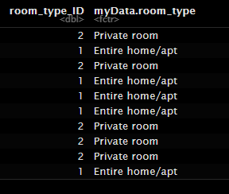
Regression: Preparation
Converting text Data to a categorical integer:
transform(myData, neighbourhood_ID=as.numeric
(interaction(myData$neighbourhood,drop=TRUE)))
Regression Formula:
lm(myData$price ~ myData$minimum_nights
+ myData$number_of_reviews
+ myData$reviews_per_month
+ myData$neighbourhood_group_ID
+ myData$neighbourhood_ID
+ myData$host_id
+ myData$room_type_ID
+ myData$availability_365
+ myData$calculated_host_listings_count)
Notes:
Challenges:
Turning text data into numerical data.

Slide 14
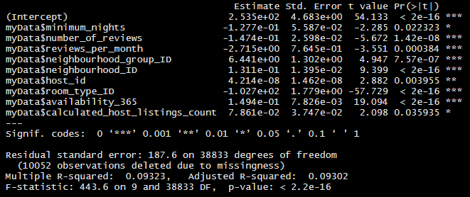
Regression: Results
Dependent Variable:
Price
Independent Variables:
Host ID
Room Type
Availability (daily)
Listing Count (by Host)
Minimum Nights
Number of Reviews
Reviews per Month
Neighborhood Group
Neighborhood
R^2: 0.093…

Slide 15

Regression: Interpretation
What We Want to Have:
What We Have Found:
Alpha Dependencies
Beta Dependencies
Notes:
Additional Data to Collect: Costs that are ancillary to owning property in NY (i.e. broker’s fees, taxes, insurance, et. al.)
Alpha:
Minimum Number of Nights
Room Type
Beta:
Neighborhood Groupings
Host Listing Counts

Slide 16
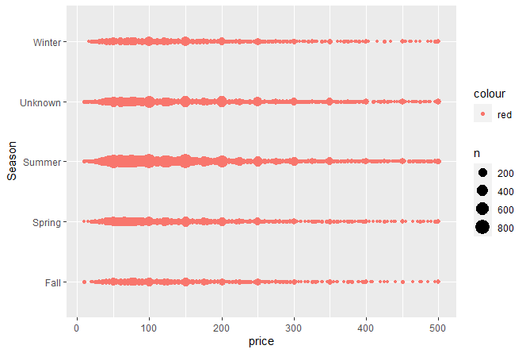

How does seasonality impact price?
Notes:
Using last review as a proxy for seasonality we can assess that rental volume is highest in the Summer, but that the price spread is consistent across all seasons. The unknow factor is listings that have no last review dates. For each of the next few views we did cap the price depicted at $500. We has listings above this range, but they were in frequent in comparison and were spread across all locations with the bulk falling into unknown.

Slide 17
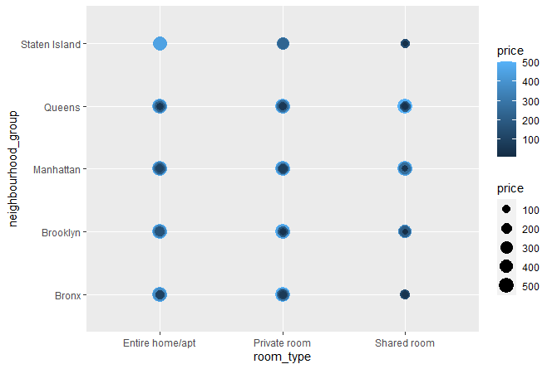

How does location and room/whole house effect price?
Notes:
We can see here that Manhattan and Brooklyn have large amounts of listing at the max price evaluated of $500, specifically in the Private room and Entire home/apt type, represented by the largest, lightest circles. Queens is a close follow with the amount of high priced listings of all types. Staten Island has very consistent pricing for each type.

Slide 18

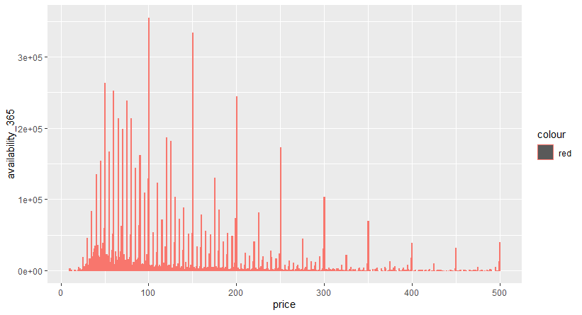
What effect does availability have on price?
Notes:
From this chart it doesn’t appear that there is any correlation with availability and price. There are a lot of low price listing with low availability, but we don’t see the price increase necessarily as availability increases in a linear way.

Slide 19
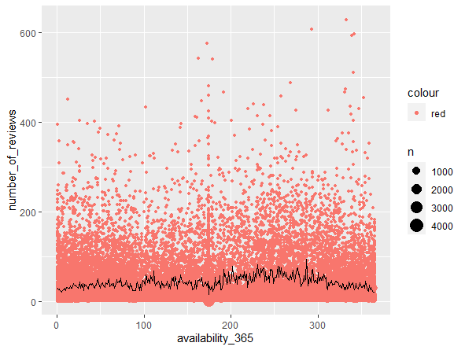

What effect do reviews have on availability?
Notes:
When we look at the impact to availability based on reviews, we again don’t see any strong correlation. The bulk of the data seems to have low numbers of reviews, but we do see some points with high availability and high amounts of reviews in the far upper right corner. The mean line depicted on the chart stays relatively flat as it travels the availability axis.

Slide 20
Interpretations

Slide 21
Interpretations
How does location and room/whole house effect price?
What effect does availability have on price?
What effect do reviews have on availability?
How does seasonality impact price?
Notes:
Nick
Room type (whole house vs private room vs shared room) has the strongest effect on price, followed closely by location of rental property. Rental properties that provide the entire space to guests rent for substantially higher nightly rates than those that require guests to share some or all of the space with the host. Properties in Manhattan and Brooklyn consistently have higher nightly rates than those in Queens, Staten Island, or the Bronx. Renting out an entire space in Manhattan will be the most profitable way to utilize Airbnb in New York.
Rooms with limited availability (30 or fewer days per year) have marginally higher average nightly rates than those available for more of the year, but the impact of availability on price is considerably less than that of location and room type.
There is no discernable relationship between reviews and availability – properties that are available to rent year-round don’t have noticeably higher numbers of reviews than properties with limited availability.
Rentals in the summer have the highest median nightly rate, while those in the winter have the lowest. To maximize profits, it’s best to be available during the summer.

Slide 22
Recommendation
Location : Manhattan and Brooklyn
Marketing message: Private sleeping spaces for guests
Timing: Send direct mailer in early spring for summer availability
Notes:
Our recommendation is to focus in on residence owners in Manhattan and Brooklyn. We would recommend that the marketing material provide information directing the potential host to either rent out their entire space or a private room. We would also recommending targeting and early spring deployment so that the host can prepare and be ready for summer rentals.

Slide 23
Questions?

